Slide 1
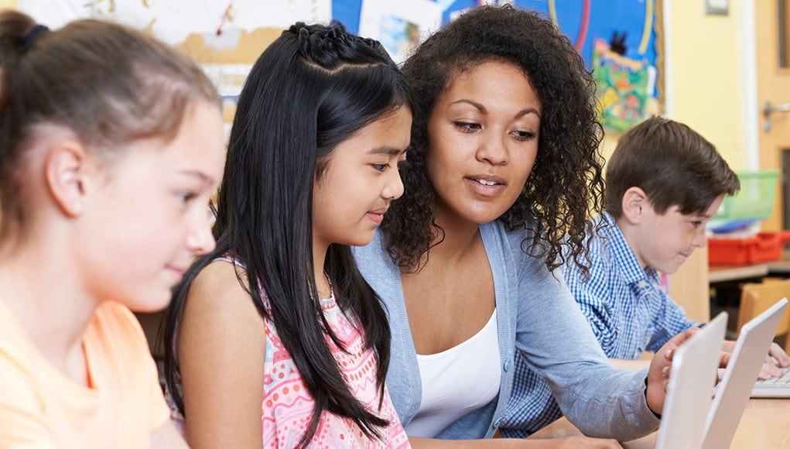
Social Emotional learning (SEL)
Student’s Name
Institutional Affiliation
Date

Slide 2
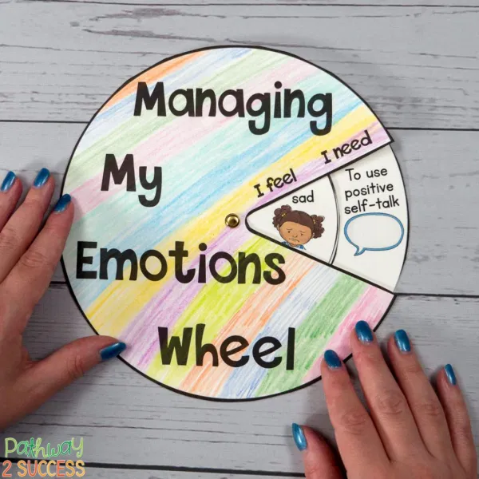
About the article
Social-emotional learning is self-control, self-awareness which includes seeing things from other peoples' perspectives, diversity appreciation, and showing of empathy and interpersonal skills that are important for life success, school and work developing process.
Individuals with strong social- emotional skills can cope with all challenges that they are experiencing in their daily lives and benefit socially, professionally, and academically.
Social-Emotional Learning skills that the students need include goals’ setting impulse' control and emotion management. They also require relationship skills like conflict resolution, cooperation, and communication.
The Mental well-being and Student's Academic have highly been affected by the pandemic COVID-19 which has revealed different inequalities that may hold them back in America.
The closing of schools and isolation has resulted in a negative effect on all students and especially those living in poverty. Apart from the effect brought to their academics, a mental health crisis has emerged because these students are no longer accessing services that were being offered to them by the schools.

Slide 3
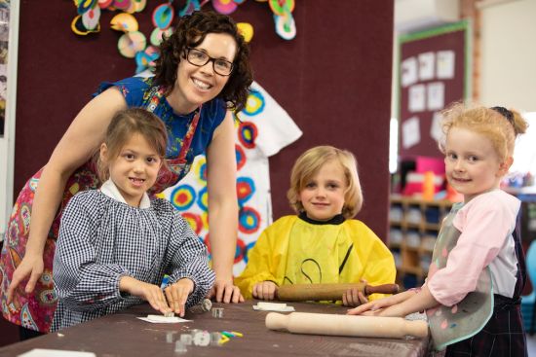
Cont…
Research shows that academic achievements and mental health is linked and chronic stress contributes to the changes in the brain's physical and chemical structure, such as memory, creativity, concentration, and cognitive skills like attention.
Cara Wellman said that stress is linked to the inability to control emotions in adaptive ways.
Teachers will face a very pressing issue in helping all students stay on track throughout the year because this virus is likely to disrupt all their learning and daily activities.
Teachers can help students through effectively having video conferencing with them, to deliver mental health services, and provide Social-Emotional Learning skills at this pandemic period where social distancing is advised.
When schools reopen, they will also have to be very methodical about checking the mental and academic state of the students where some will still be having trauma, grief, and anxiety due to the loss of their loved ones while others may feel the pressure to face the new school year head-on.

Slide 4
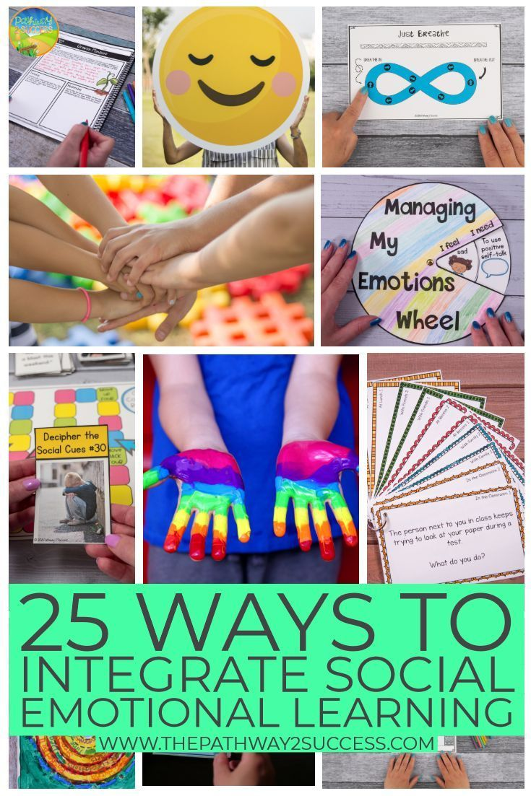
Strategies for strengthening the Social Emotional Learning Information
Focusing on relation first where the teachers can act as a powerful buffer against all the trauma effects by helping students develop a supportive and safe learning environment. Morning meetings, regular student check-ins are some of the strategies that will help in building student relationships first.
II. Strengthening diagnostic testing by giving the students low-stakes assessment such as quizzes and exit tickets that will assist the teachers in gauging how much extra supports that the students will need and the amount of time that should be spent going through all materials from the previous years and what new topics should be tackled.
III. Differentiating instruction especially for the vulnerable students where teachers can work with them to ensure that they get all the support they need by taking their skills and knowledge stock.
They can also help them in differentiating instruction by providing them with choices, connecting their curriculum to their interests, and provide them multiple opportunities to show and explore their learning.

